Slide 1

Numerical Methods Project
Roll: 2207007, 2207008, 2207009

Slide 2
Numerical Methods Project
Name: Md Fahim Hossen
Roll: 2207007
Role: Folder structure and slide creation

Slide 3
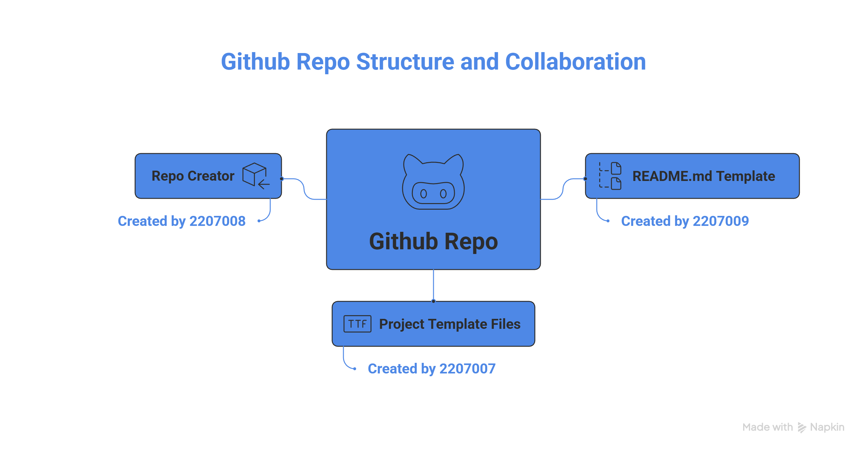

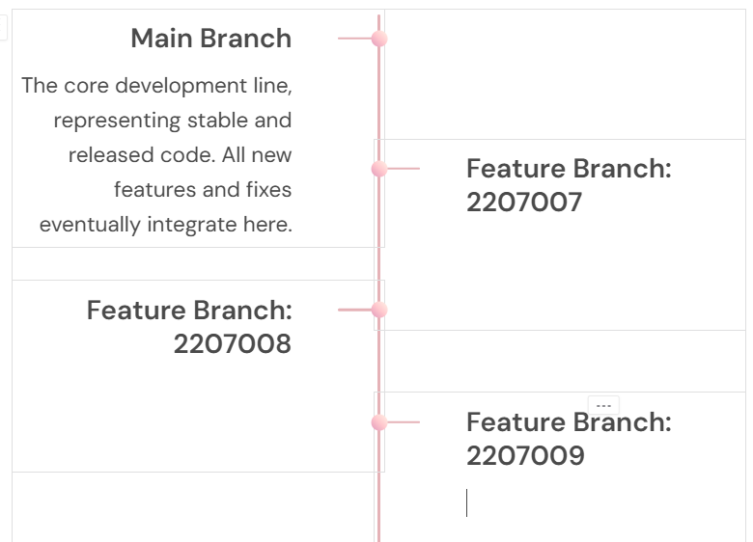
My contribution to the project
Basic Structure
Slide template
Created the basic file and folder structure for the whole project
Made the planning of slide creating and visuals

Slide 4
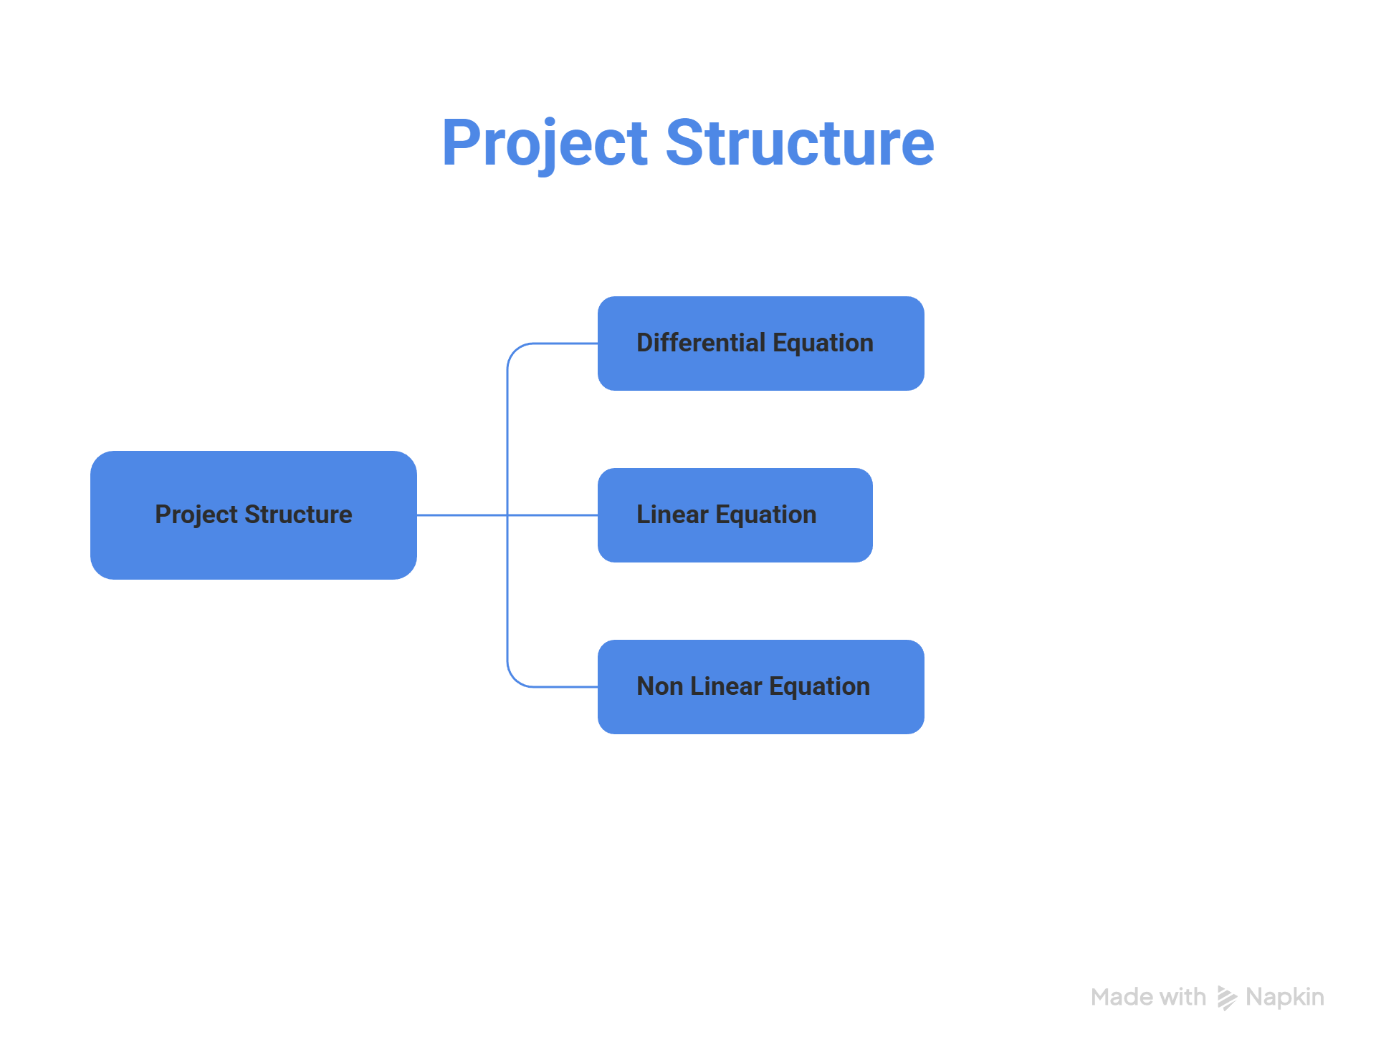
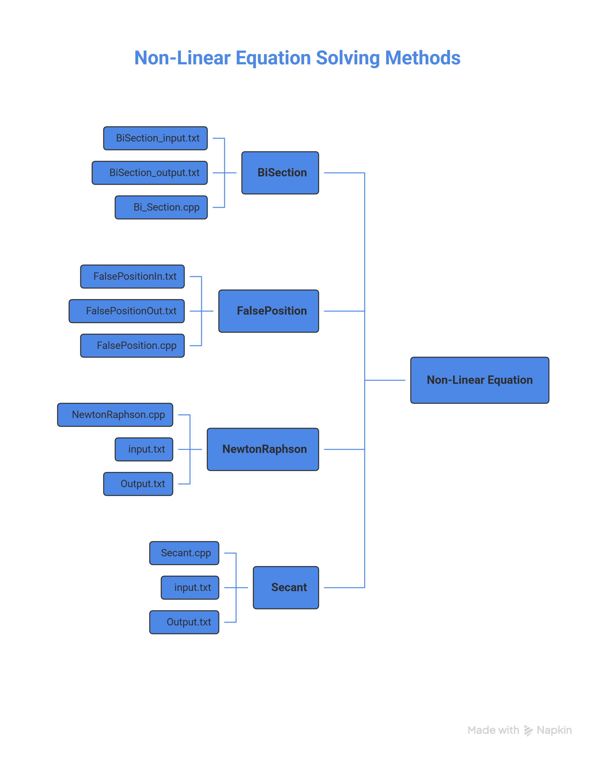
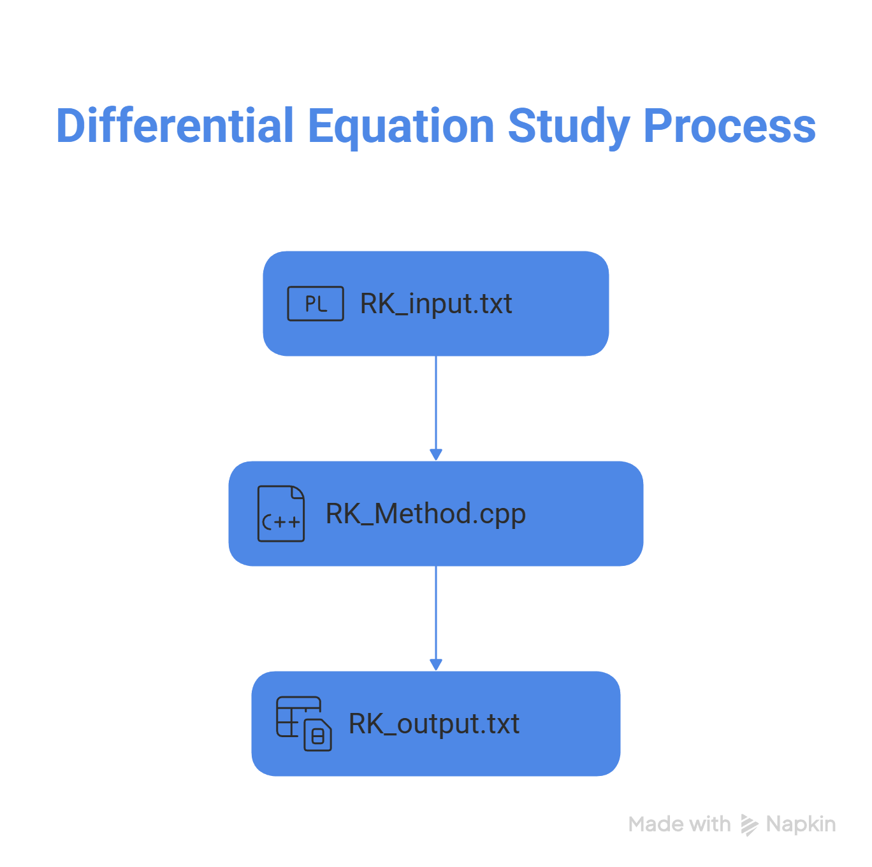




Slide 5
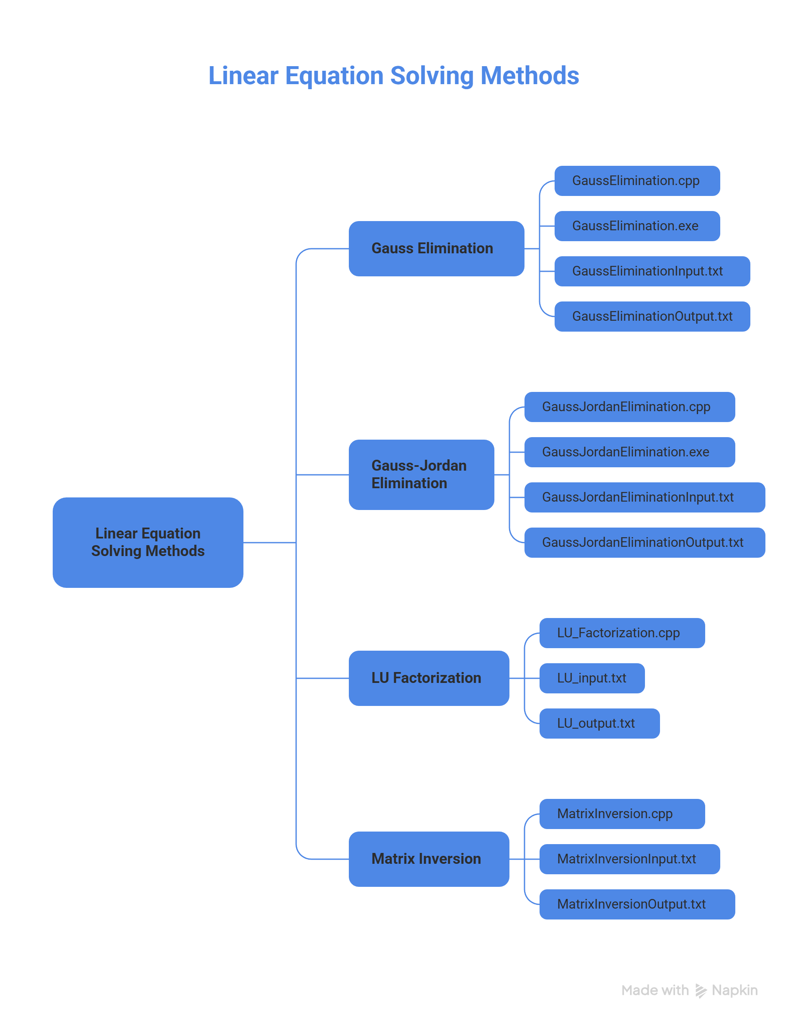


Note: These folder structures were later changed according to the need

Slide 6
My contribution to the project
Method Implemented by me
False Position Method
Newton Raphson Method
Secant Method
Simpson’s 1/3 Method
Simpson’s 3/8 Method
Differential Equation

Slide 7

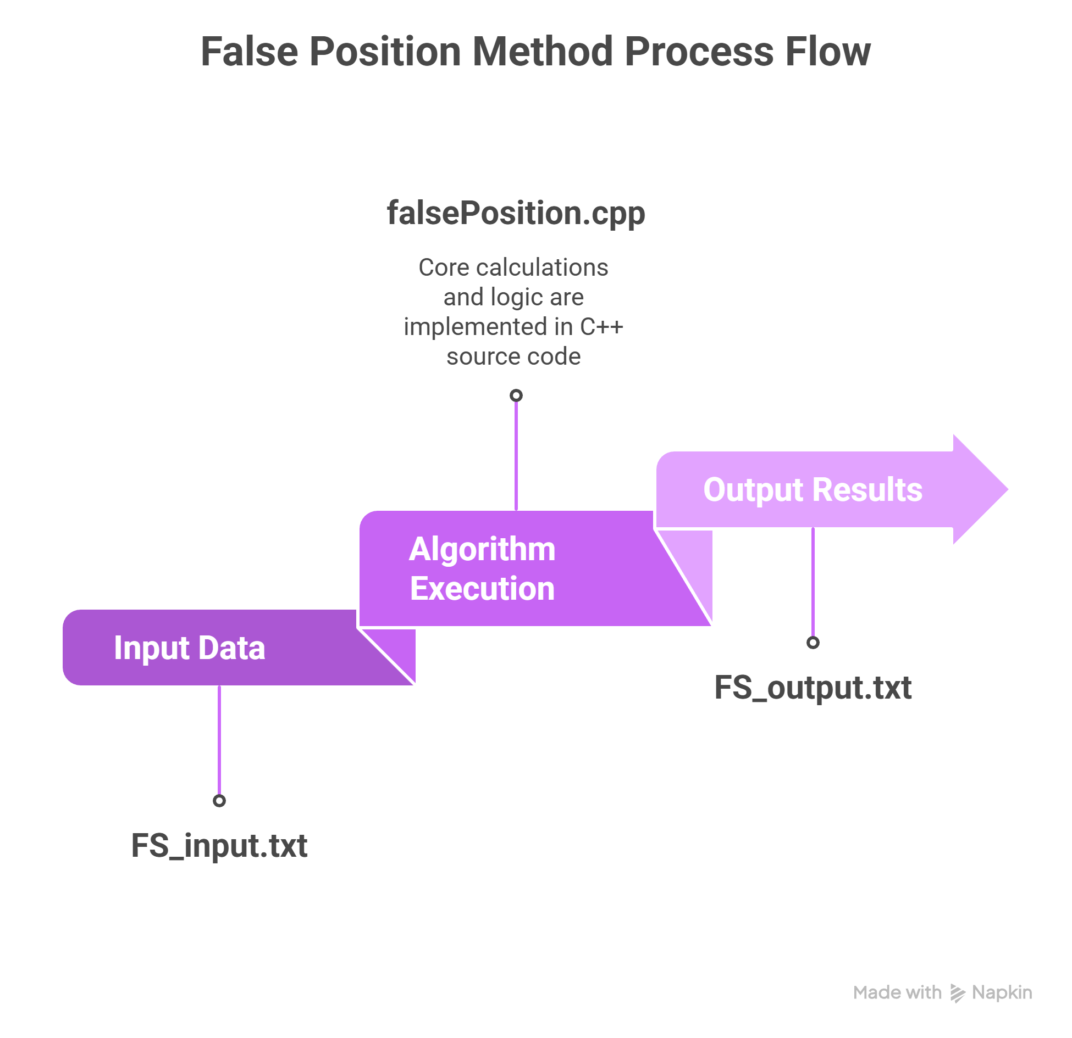
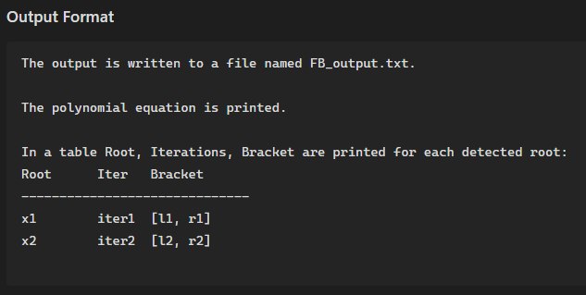
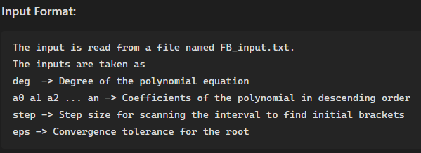


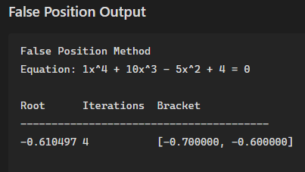
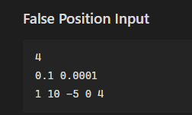

2207007
False Position Process

Slide 8
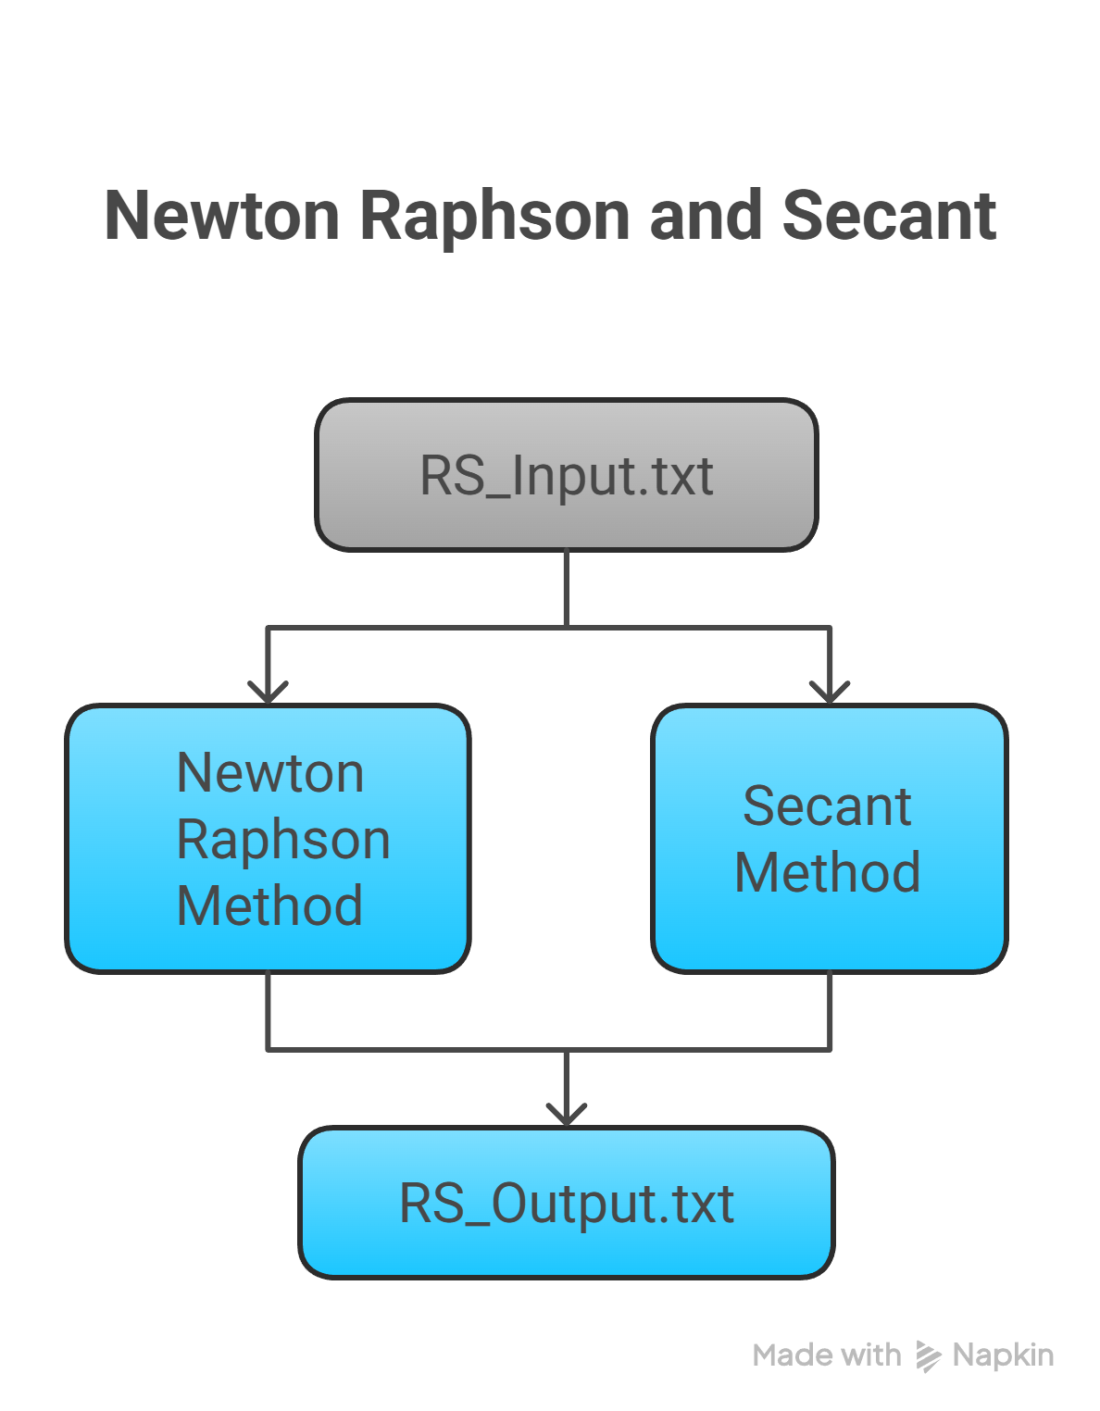
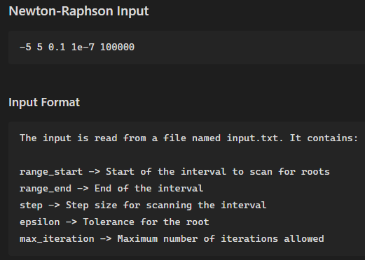
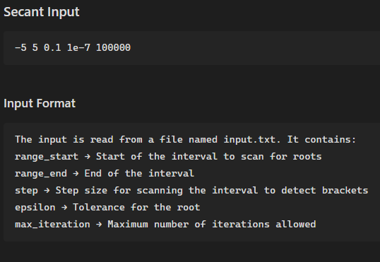
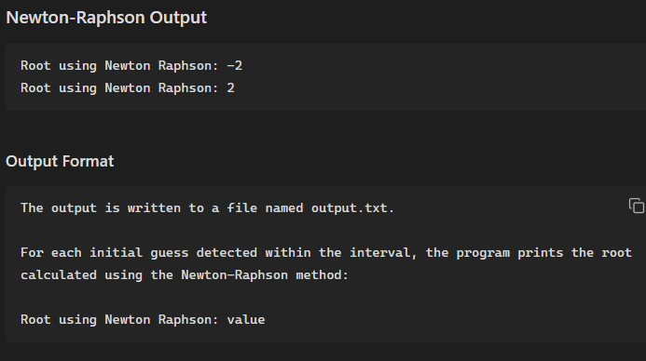
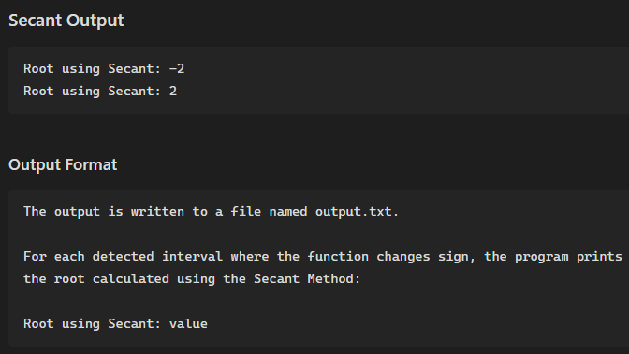

2207007

Slide 9
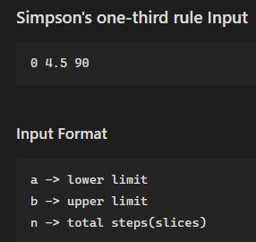
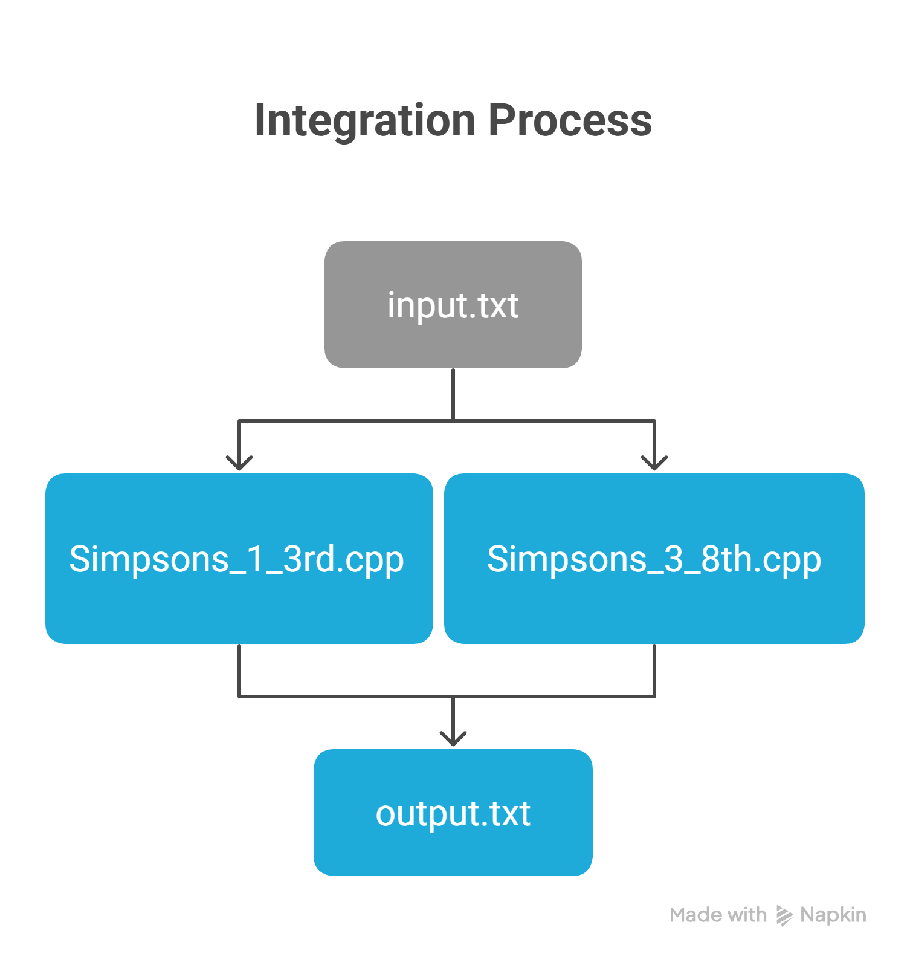
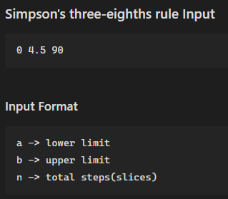
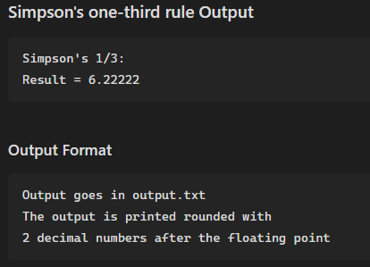
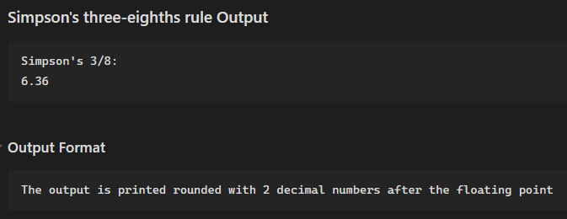

2207007

Slide 10
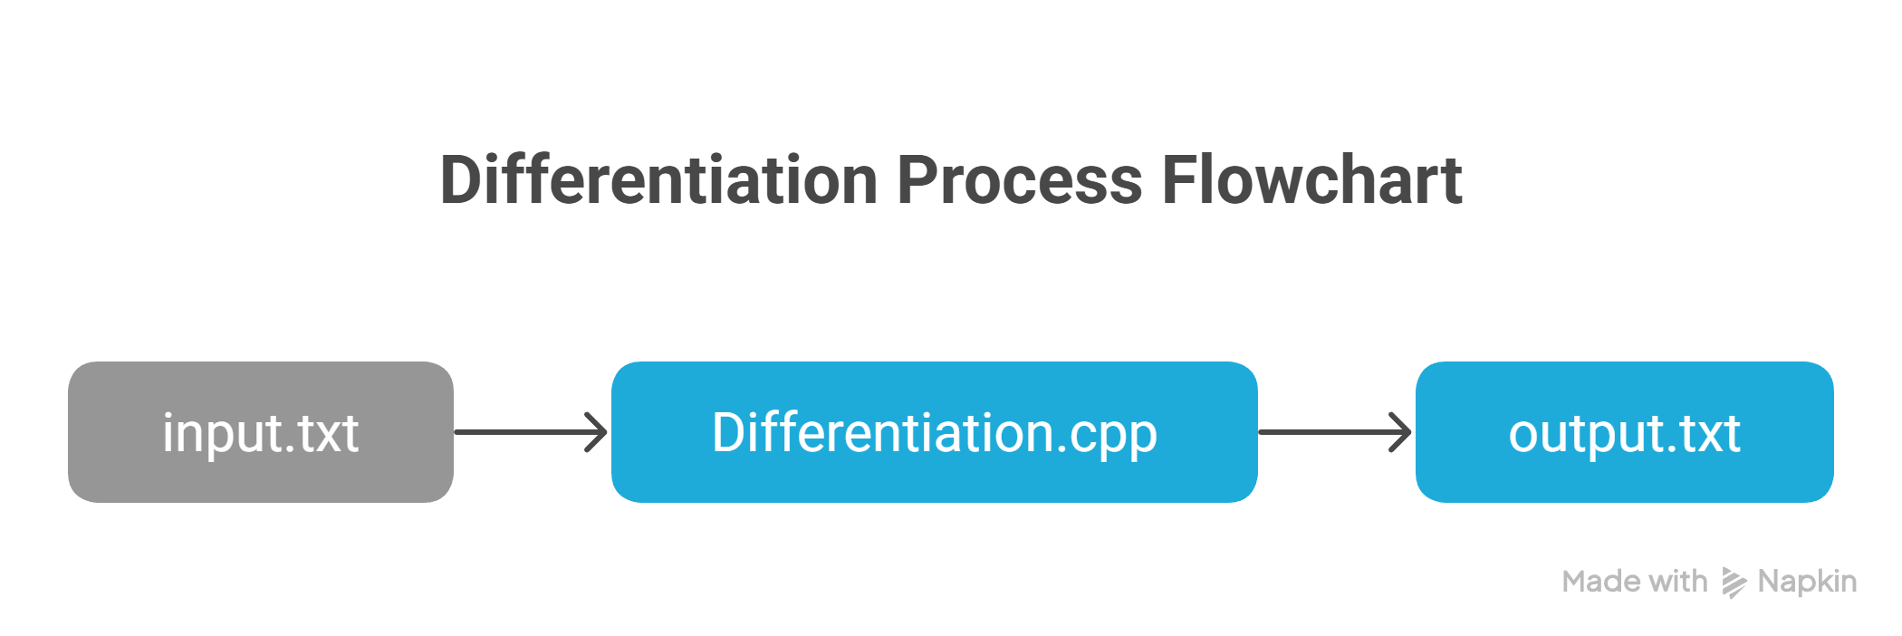

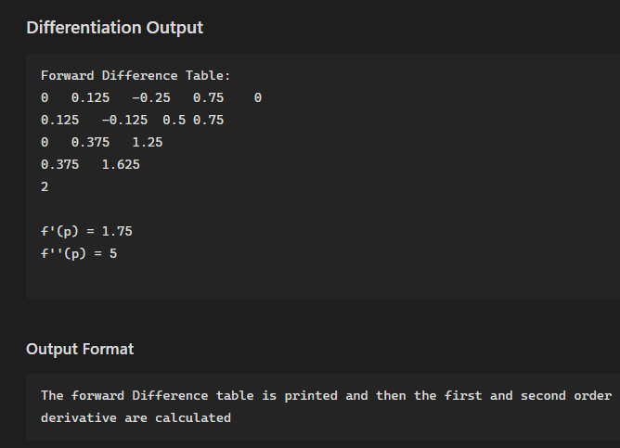
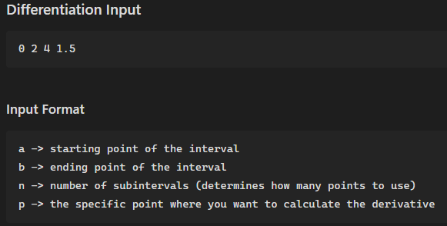
2207007

Slide 11
Thank You for Your Attention
I will now hand over to 2207008, who will explain the next steps of the project.

Slide 12
Numerical Methods Project
Name: Kazi Sakibul Hasan
Roll: 2207008
Role: Implementation & Version Control

Slide 13
My Role in Version Control
Repository
Collaboration
Created and managed Git repository
Enabled smooth teamwork and integration
Management
Stability
Handled branches and merges efficiently
Resolved conflicts for main branch

Slide 14
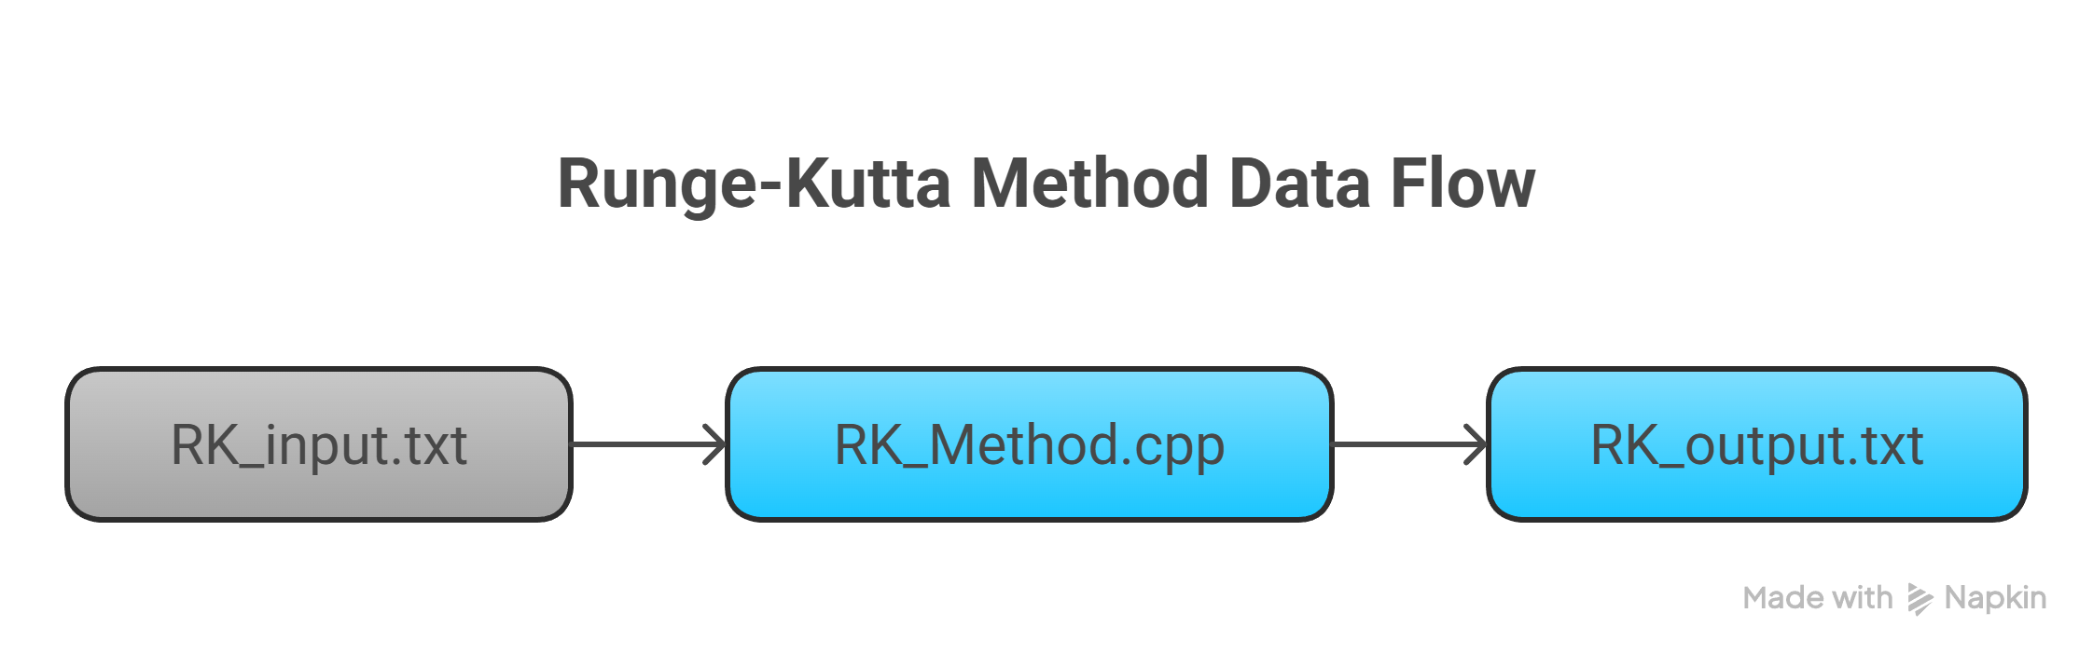
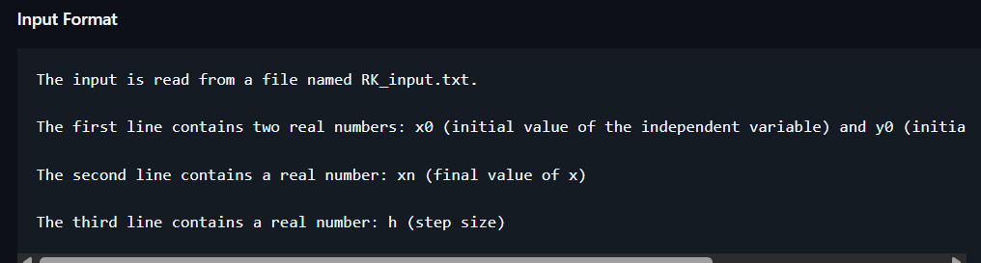
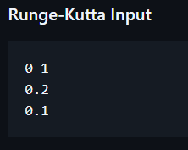
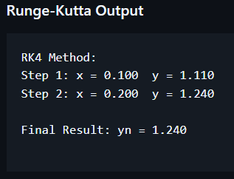
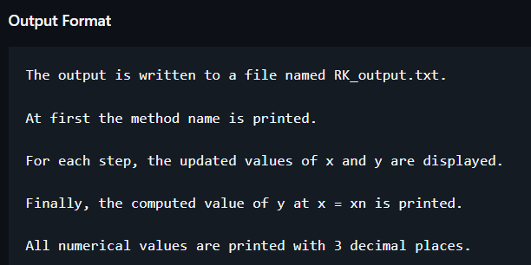
Coding Focus
I/O Format In README.md
I have implemented a file-based input and output system for each numerical method in the project. The source code for every method is organized into separate, method-specific folders, ensuring clarity and modularity in the overall project structure.
All input and output formats for the implemented modules are documented in the README.md file.

Slide 15
Numerical Methods that I Implemeted
Bisection Method
LU Decomposition
A reliable technique for finding roots of nonlinear equations by repeatedly halving intervals.
Factorizes a matrix into lower and upper triangular matrices to solve linear systems efficiently.
RK4 Method
A fourth-order Runge-Kutta method used to solve ordinary differential equations with high accuracy.

Slide 16
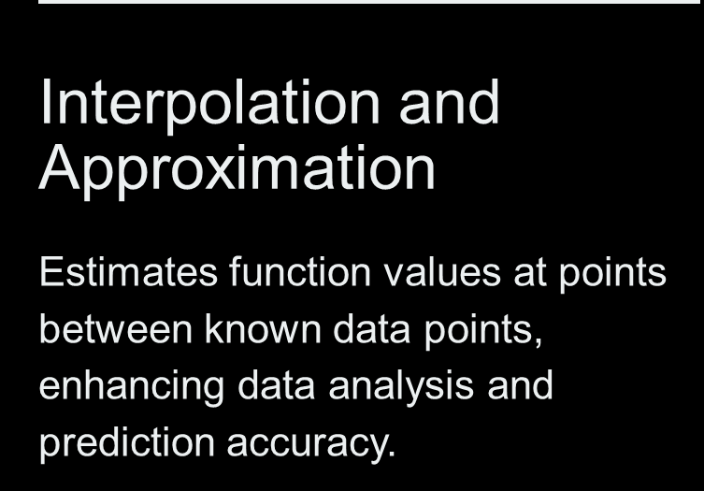
Numerical Methods that I Implemented
Newton's Forward Interpolation
Newton's Backward Interpolation
Estimates function values at points near the start using equally spaced known x values.
Estimates function values at points near the end using equally spaced known x values.
Divided Difference Interpolation
Divided Difference for Error Calculation
Estimates function values when known x points may not be equally spaced, providing greater flexibility.
Calculates the residue error, enhancing precision by analyzing differences in the estimated values.

Slide 17
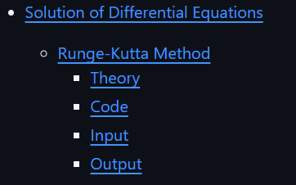
Theory and Algorithms Overview
SEE README.md
The brief theory and algorithm for the methods implemented is included in the README.md.

Slide 18
Thank You for Your Attention
I will now hand over to 2207009, who will explain the next steps of the project.

Slide 19
Numerical Methods Project
Name: Md Istiaque Ahmed Asif
Roll: 2207009
Role: Implementation & README.md template

Slide 20
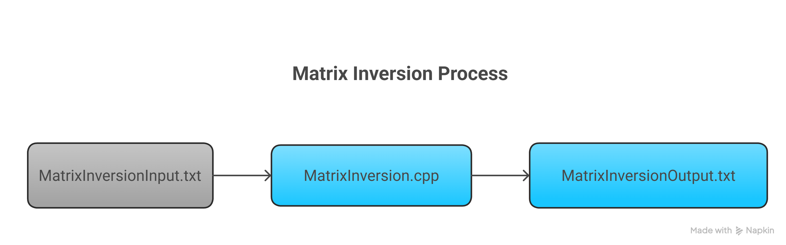
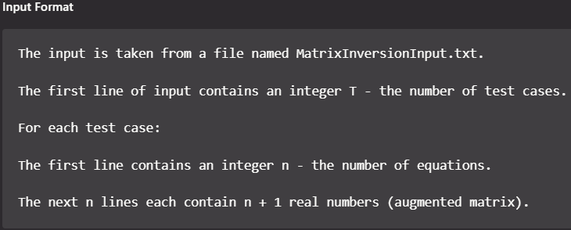
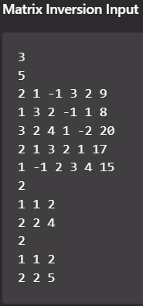
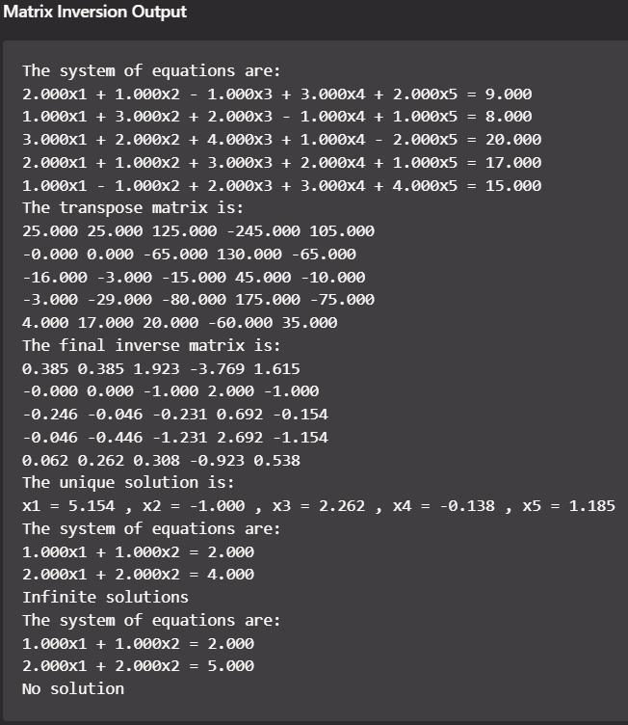
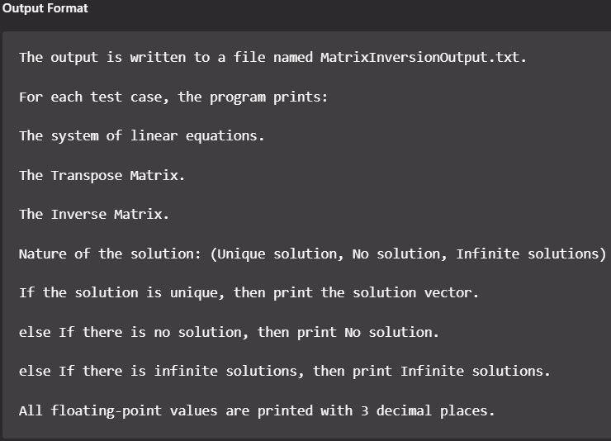
Coding Focus
I/O Format In README.md
I have Implemented file based I/O for each methods
All input and output formats for the implemented modules are documented in the README.md file.

Slide 21
Numerical Methods that I Implemeted
Gauss Elimination Method
Gauss Jordan Elimination Method
It solves a system of linear equations by converting the equations into an upper triangular matrix and then finding the unknowns using back substitution.
It solves a system of linear equations by transforming the matrix into reduced row-echelon form so that the solution is obtained directly without back substitution.
Matrix Inversion Method
It solves a system of linear equations by finding the inverse of the coefficient matrix and multiplying it with the constant matrix.

Slide 22
Numerical Methods that I Implemented
Linear Equation
Transcendental Equation
It determines the best-fit straight line for the given data using the least square regression to minimize the total error.
It fits exponential, logarithmic, or power curves by converting them into a linear form and applying the least square regression.
Curve Fitting: Regression
Polynomial Equation
It fits a polynomial curve for the given data by using the least square regression to minimize the squared differences between actual and calculated values.

Slide 23
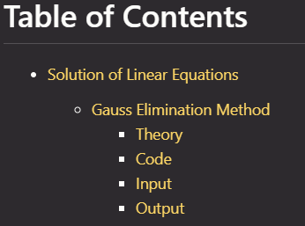
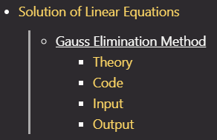
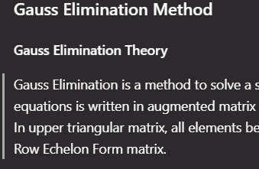
README.md:
Table of Contents & Hyperlinking
Navigation Menu
Clickable Hyperlinks
The Table of Contents serves as a navigation menu.
Each item is a clickable hyperlink referencing sections.
Direct Navigation
Clicking "Gauss Elimination Method" jumps to its section.

Slide 24
Section Structure
Theory
Code
Explains the working principle of each numerical method clearly.
Shows the program implementation of the method.
Input
Output
Shows the input given by the user.
Displays results produced by the program for verification.
Input Format
Output Format
Describes the input format, providing clarity for users.
Describes the output format. Which is expected from the program.

Slide 25
Project GitHub Repository
🔗 GitHub Repository Link: https://github.com/Sakib-008/Numerical-Lab-Project
Thank You

